Slide 1
PAEDIATRIC AIRWAY- Anatomy ,foreign bodies.
Presenter: Dr.Kuppuswamy

Slide 2
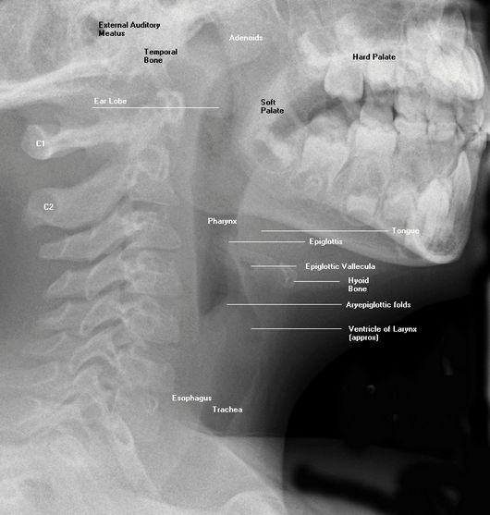
Paediatric upper airway anatomy.
In school age and older children, the airway is similar to the adult airway- normal structures are usually well seen.
Infants and young children have a short neck, redundant soft tissues, and limited cooperation make airway evaluation more challenging.

Slide 3
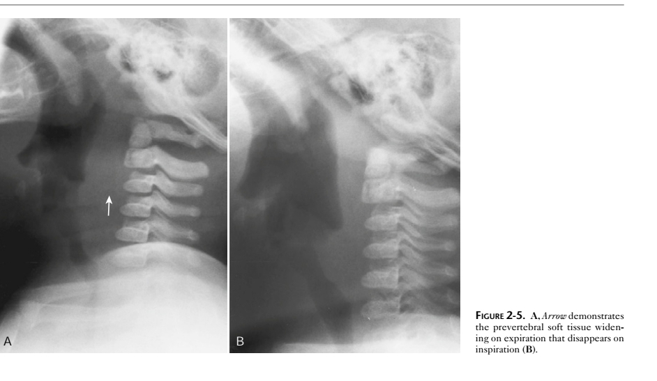
Techniques
For acute airway abnormality- frontal and lateral views are obtained.
To evaluate the site and size of the tonsils and adenoids- single lateral view is done,
Images should be obtained during inspiration to avoid buckling of the airway and normal airway collapse,
Neck extension- helpful when evaluating retropharyngeal soft tissues.

Slide 4
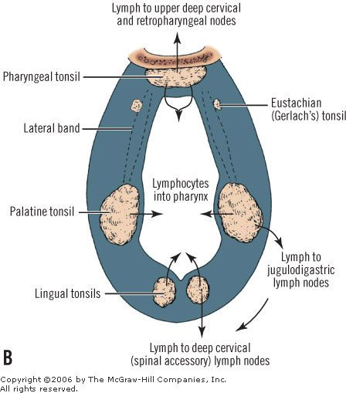
Waldeyer’s ring
A ring of lymphoid tissue located in the nasopharynx and oropharynx at the entrance of aerodigestive tract,
Composed of
Palantine (faucial tonsils)
Adenoids (nasopharyngeal tonsils)
The lateral bands on the lateral walls of the oropharynx.
Lingular tonsils at the base of the tongue.

Slide 5
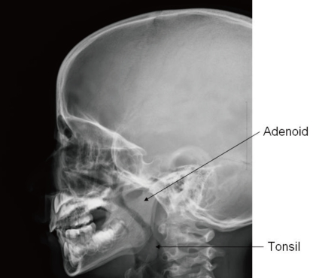
tonsils
Children have more prominent tonsils than adults.
The size of the lingual tonsils and pharyngeal tonsils vary with age. After 3 months of age, the tonsils become progressively larger and reach maximum size at 2–10 years of age.
The tonsils are best depicted on a lateral radiograph obtained with the patient’s mouth closed and the patient in deep inspiration without swallowing.

Slide 6
tonsils
The tonsils may enlarge as a result of infection and gastroesophageal reflux. Increased soft tissue in this region can result in obstructive sleep apnea and chronic ear and sinus infections.
The lingual tonsils are considered enlarged if they occupy greater than 50% of the oropharynx.
the pharyngeal tonsils are considered abnormal if they narrow the nasopharynx.

Slide 7
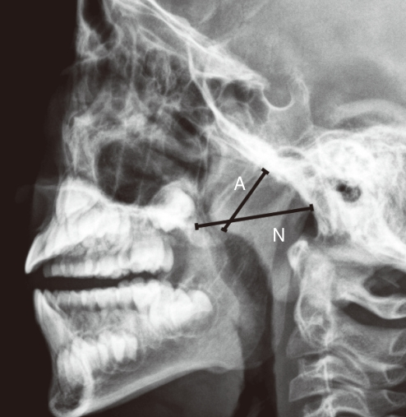
FUJIOKA METHOD
Used to diagnose adenoid hypertrophy.
Adenoid Nasopharyngeal Ratio.-- between adenoid and nasopharyngeal space.
The distance between the outermost point of convexity of adenoid shadow and spheno-basiocciput (A) is divided by the distance between spheno-basiocciput and posterior end of the hard palate (N)
Minimal ratio < 50%
Mild- <62%
Moderate- <75%
Severe- <88%

Slide 8
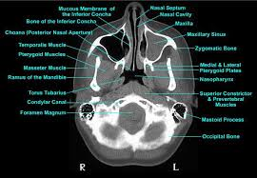
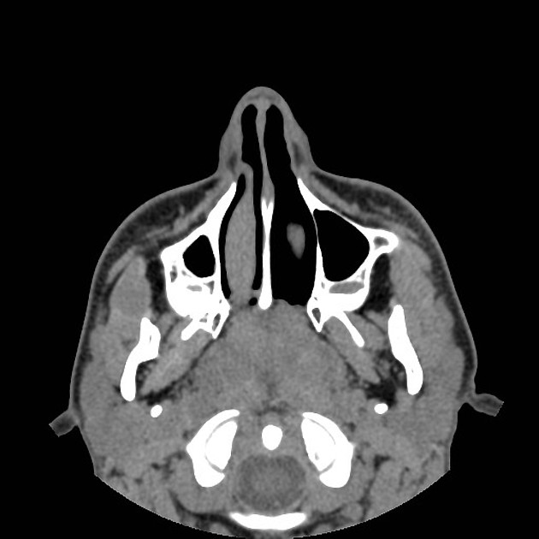
Adenoid enlargement –obstructing the nasopharynx air column.

Slide 9
Airway foreign bodies in children
Airway foreign bodies in children are potentially fatal.
Immediate recognition is important
Epidemiology
Children under the age of four years are at increased risk of foreign body (FB) aspiration.
slight male predominance.
Clinical presentation
Most children (~70%) are witnessed to have had a choking event at the time of aspiration.
Children may otherwise present with cough, dyspnea, or irritability

Slide 10
Pathology.
Most (70-90%) foreign bodies are organic( seeds and nuts).
Inorganic foreign bodies vary can include teeth, coins, pins, pens/crayons, etc.
Aspirated foreign bodies have a predilection for the right tracheobronchial tree.

Slide 11
Imaging findings
depend on whether the (FB) is opaque or not.
Frontal and lateral radiographs of both upper airway and chest are extremely helpful.
If no (FB) is visualised ,the abdomen may be radiographed. ,
indirect signs of airway obstruction can be detected, including overdistention of the hypopharynx and prevertebral soft-tissue swelling
CT is usually indicated only to assess for a residual foreign body after bronchoscopy or when there is a suspicion of serious complications, such as aortic perforation.
Oesophageal foreign bodies may also cause airway obstruction because of mass effect and inflammation

Slide 12
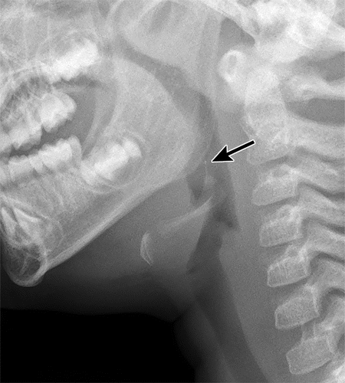
Foreign body in the upper airway
Lateral neck radiograph shows
Upper airway foreign body in a 5-year-old boy with dysphagia.
vertically oriented slender fish bone (arrow) impacted into the epiglottis.
It is important to scrutinize the upper airway at radiography because the appearance of foreign bodies may be subtle.

Slide 13
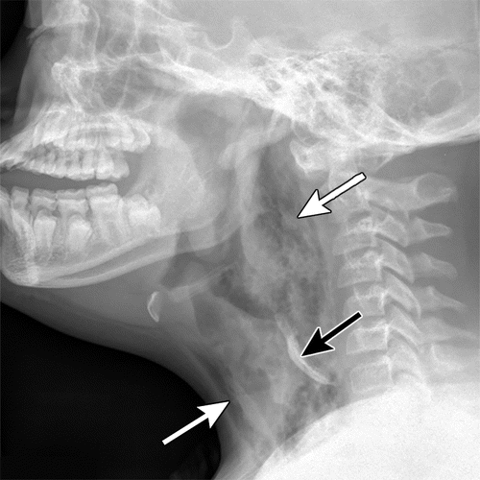
Foreign body in the upper airway complication
Lateral neck radiograph shows Upper airway foreign body in a 5-year-old boy with Down syndrome who presented with difficulty breathing and drooling.
a radiopaque foreign body (black arrow) that proved to be a bone from soup he had recently eaten.

Slide 14
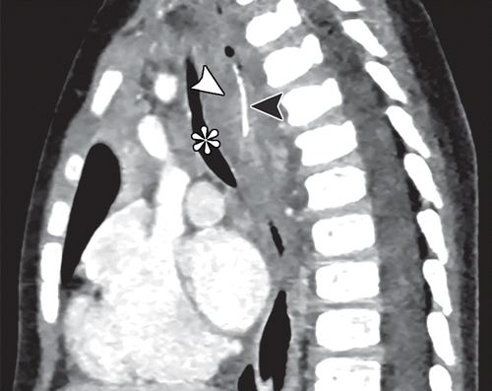
Sagittal contrast-enhanced CT image of the chest image shows a thin linear hyperattenuating structure (black arrowhead) within the esophagus, with surrounding inflammatory changes ( mediastinitis) as a result of esophageal perforation. narrowing and bowing of the trachea (*) anteriorly.

Slide 15
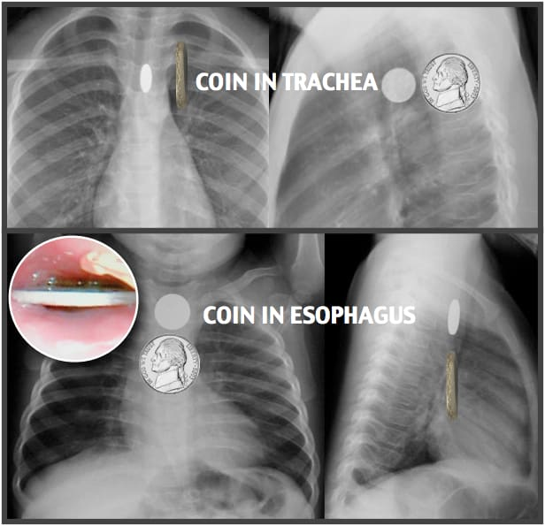
Foreign body in the trachea and oesophagus have different orientations on radiographs.
Oesophageal foreign bodies lie transverse while tracheal foreign bodies have a sagittal orientation because of lack of cartilage in the posterior aspect of the trachea (frontal view radiograph)

Slide 16
Lower Airway foreign bodies.
Most aspirated foreign bodies (75%) lodge in the lower portion of the airway, 13% of these aspirated foreign bodies lodge in the trachea, 60% in the right lung, and 23% in the left lung.
Only 2% of patients experience bilateral foreign bodies .
Clinical features-
choking followed by a symptom-free period, which may delay diagnosis.
In children with a chronic cough or recurrent pneumonia, an aspirated or ingested occult foreign body should be considered.

Slide 17
Lower Airway foreign bodies.
Imaging Features
Most lower airway foreign bodies are radiolucent because they are composed of organic material (ie, food).
only approximately 10% of aspirated foreign bodies are radiopaque
In most cases, especially if the foreign body is nonocclusive, chest radiographs will be normal
In partial airway obstruction, which is most common, there may be evidence of unilateral hyperinflation, atelectasis, or mediastinal shift.
In the setting of partial airway occlusion, expiratory views have been shown to increase the diagnostic accuracy and should be obtained when possible

Slide 18
Lower Airway foreign bodies.
In inspiration, when the airway calibre is larger, air rushes into the lung around the foreign body.
In expiration, when the airway narrows, air is trapped distal to the foreign body.
Because of this ball-and-valve mechanism, the affected lung will remain lucent in expiration .
Evaluate carefully for complications such as pneumomediastinum and pneumothorax.
CT is usually not indicated because it will delay diagnosis.

Slide 19
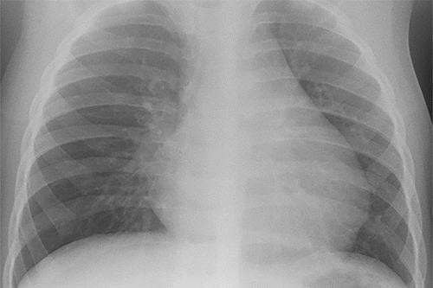
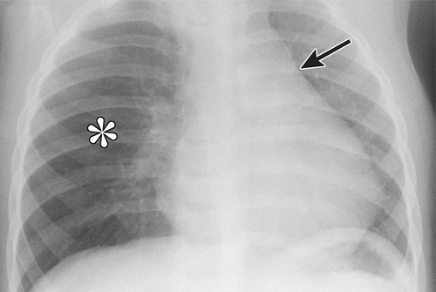
Foreign body aspiration in a 24-month-old boy who presented with an episode of choking and wheezing.
Frontal chest radiograph acquired in inspiration shows subtle asymmetric hyperinflation of the right lung, as demonstrated by increased lucency and mass effect.
Frontal chest radiograph acquired in expiration shows normal reduction in volume of the left lung. However, persistent airtrapping is depicted in the right lung (*), as well as a more-pronounced mediastinal shift to the left (arrow). At bronchoscopy, a piece of apple was found within the right main bronchus.

Slide 20
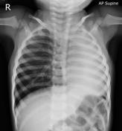
left lung collapse due to ground nut in left main bronchus.

Slide 21
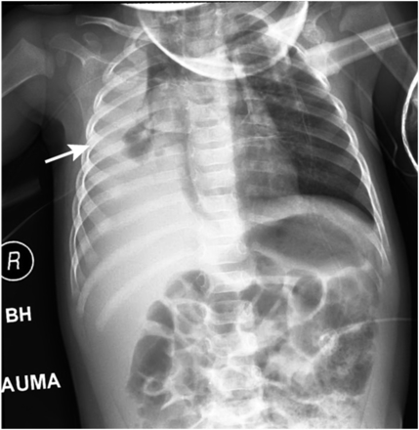
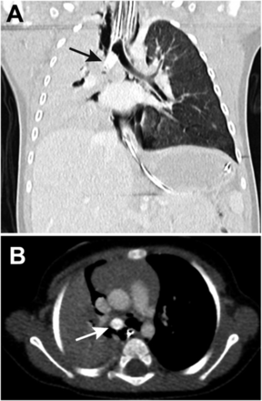
scans
Sagittal (A) and axial (B) computed tomographic scans.
An ovoid, well-circumscribed, hyperattenuating lesion (arrows) is located in the proximal right mainstem bronchus, causing complete right lung collapse.
anteroposterior radiograph showing almost complete opacification of the right hemithorax (arrow)

Slide 22
References
Anatomy for diagnostic imaging Stephanie Ryan 3rd edition.
Asli M, Ilknur H et al. functional anatomy and physiology of Airway. IntechOpen 2019.
Teach me anatomy.
Kathryn E, Darras AT, et al. Imaging Acute Airway Obstruction In Infants and Children. RadioGraphics.2015; vol35,No 7

